Slide 1
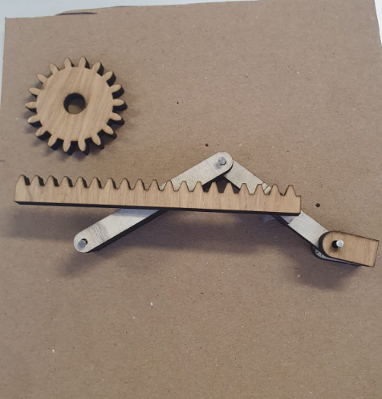
Very general overview of what is needed in code:
Front and back wheel move forward and backwards using a L298N
Front wheel able to rotate using 180 servo (will only need to rotate 60° left and right)
Side arms controlled by gear and rack controlled by a 360° servo to move wheel up and down
Servos going through the servo shield
All must be done through the adafruit airlift wifi shield
Servo
Arduino
Servo
Servo
Arm
Arm
Payload Area
360 servo
Wheel

Slide 2
Component list
Arduino Uno
https://www.adafruit.com/product/4285 Airlift wifi shield
https://www.adafruit.com/product/1411 Servo shield
https://thepihut.com/products/towerpro-servo-motor-mg996r-metal-gear-360 360 servos
https://thepihut.com/products/towerpro-servo-motor-mg996r-metal-gear-180 180 servos
https://thepihut.com/products/l298n-motor-stepper-driver L298N motor drivers
https://thepihut.com/products/dc-gearbox-motor-tt-motor-200rpm-3-to-6vdc Motors

